Slide 1

Workshop on fisheries management measures in Natura 2000 sites in the Mediterranean Sea
10-12 October 2017
Theme 2 : Finding solutions
___
How fishing activities are taken into account in Natura 2000 sites in France

Slide 2
Fisheries in French Natura 2000 sites
Natura 2000 principles in France (MTES)
How fishing activities are taken into account in Natura 2000 sites in France (MTES, MAA)
Implementation of the fisheries risk methodology for Natura 2000 habitats : initial feedback (AFB)

Slide 3

Natura 2000 principles in France
1) Dialogue and managment plan
For each site a steering committee
→ composed of local authorities, environmental NGOs, stakeholders, scientists
→ validates a management plan
2) Implementation of measures
Voluntary actions, based on financial incentives
Adoption of regulatory measures by competent authority
monitoring...
8
DOCOB
3) Natura 2000 « appropriate assessment » system
The objective is to prevent potential damage of habitats and species
Activities, plans, projects, can not be authorized in case of significant impacts
Fishing activities
Specific prodedure

Slide 4

Natura 2000 principles in France
For fully marine sites:
The responsible authority is the maritime prefecture
  Establishes the Steering Committee
  Can chair the Steering Committee
  Develops and monitors its implementation
Usually the technical operator is the French Biodiversity Agency. The objective is to pool technical expertise.
  The Agency develops the management plan under the authority of the maritime prefecture
  Several sites are managed by local authorities in partenership with the French Biodiversity Agency
Link with MSFD and Marine Spatial Planning Directive
According to French law :
N2000 management plan must be compatible with the environmental objectives set out in the MSFD action plan
Implementation of the MSFD at a subregional scale represents the environmental pillar of the EU- Marine Spatial Planning directive

Slide 5
Natura 2000 – fishing activities
  Regarding fishing activities
  French law dictates that :
The risk posed by commercial marine fishing activities to the achievement of conservation objectives be assessed for each site
Where a risk is identified, the administrative authority shall take regulatory measures, in accordance with the rules of the CFP.
As a result, fishermen are exempt from individual impact assessments within Natura 2000 sites

Slide 6
Natura 2000 – fishing activities
Presentation tp steering committee
Adoption of the MP by maritime prefecture
Technical elaboration of the DOCOB
Management implementation
DOCOB
Fishering activities specifics
Risk analysis of fishing activities
Decision of competent authority in charge of fisheries
Adoption regulatory measures
Measures proposals
The “risk analysis” applies to all commercial fishing activities in each Natura 2000 site. It is conducted, by the French Biodiversity Agency, in partnership with fisheries committees and local government services
CFP (art. 11 or 20) if relevant
Regulatory measures are adopted by the competent authority, in accordance with the rules of the CFP, so they may be applied to French and foreign vessels

Slide 7
Natura 2000 – fishering activities
Summary of the methodology
Risk analysis = Probability that an habitat is affected by a fishing event
Objectives:
→ to ensure homogeneity at national level
→ to be operational and adapted to local context
+ consideration of contextual parameters
Proposals of management measures

Slide 8
Fisheries in French Natura 2000 sites
Work in progress
The methodology is being updated, and the main objectives are:
To explain how to take into acount generic data on habitat sensitivity
To explain how to take into acount local parameters to prioritize measures
Diagram under reflection
Habitat sensitivity
Pressures generated by activities
Based on generic information
Risk of habitat degradation
Ecological state of habitat,
Local characteristics of fishing activities
Risk of undermining the conservation objectives
Socio-economic issues,
Presence of other activities
Prioritization of measures

Slide 9
Progress Report
Risk analysis of fishing activities
Proposed Measures
Decision of competent authority in charge of fisheries
Adoption of regulatory measures
Methodology currently being updated
CFP (art. 11 or 20) if relevant
One site in Seine bay has completed the analysis and proposed management measures in Eastern Channel
+
Natura 2000 in the offshore marine environment

Slide 10
Art. 11 and 20 CFP
Pros and cons table
Article 11 |  | Article 20
 | Lenghty adoption process (6 + 3 months) | Short consultation (2 months)
 | Costly and complex process | Quicker and cheaper process
Measures adopted accepted |  |  | Risk of disagreement about measures adopted
Sharing of information and methodologies between members states

Slide 11
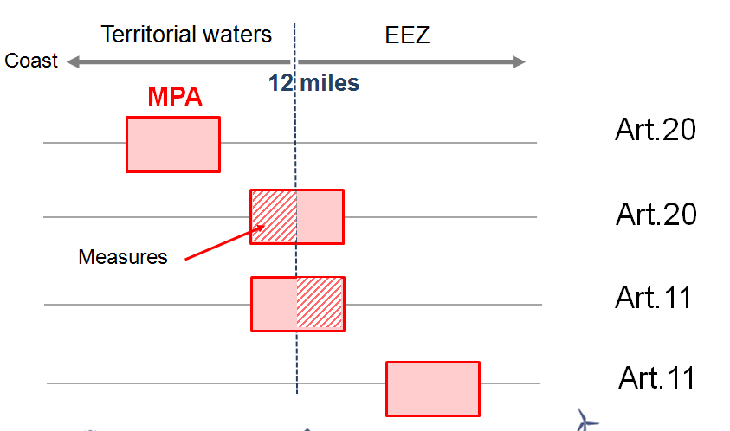
Different management situations of N2000 sites
Diagram illustrating management options
→ Options in new « ministerial circular » in 2018

Slide 12
Finding solutions:
Initial feedback on risk assessment method
(French Mediterranean sites)

Slide 13
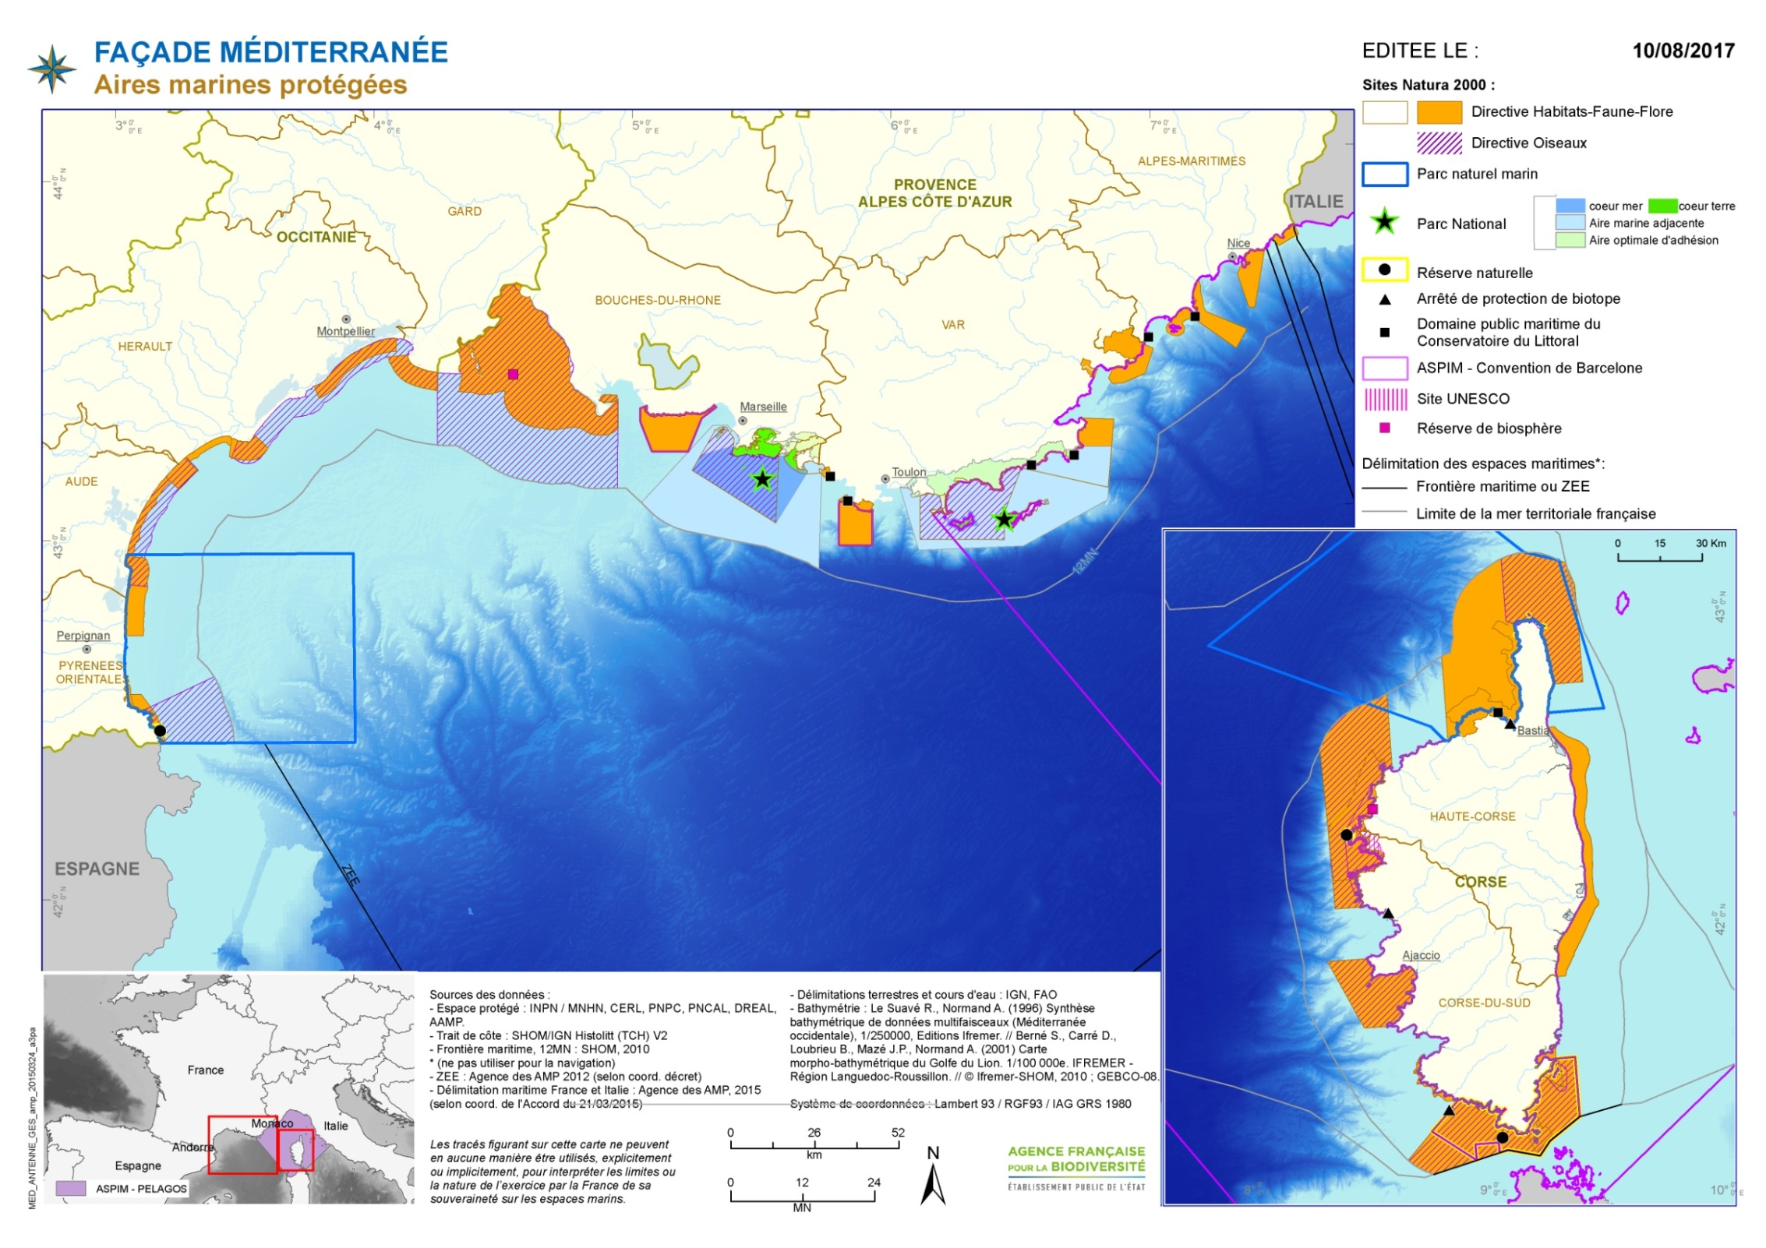
testing sites for risk analysis measure 40 EMFF
sites where risk analysis need to be validated

Slide 14
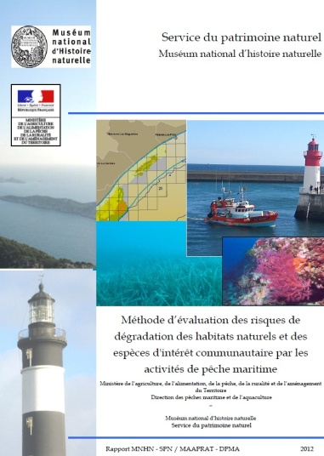
Implementation of a national methodology
AFB tested the method through a partnership agreement with regional fisheries committee (CRPMEM) in the 3 administrative regions.
Risk methodology combines 3 levels of information:
  Habitats
  Fishing activity
  Combination = potential risk of degradation
Method tested in both Natura 2000 Sites with a validated management plan and those developing a management plan

Slide 15
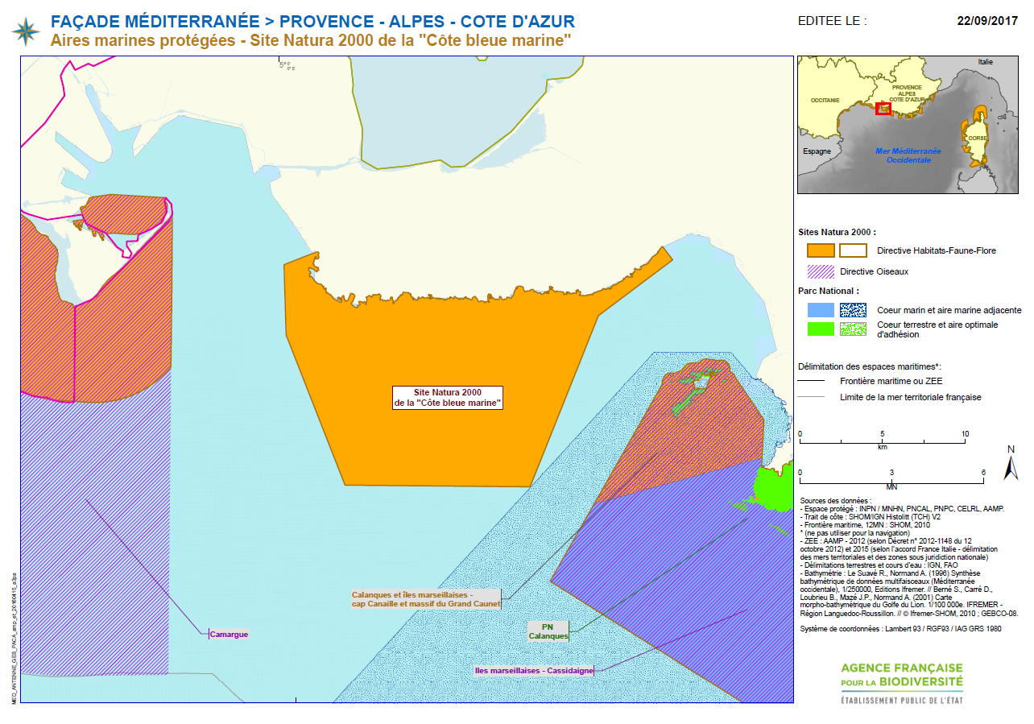
Paca: Côte Bleue

Slide 16
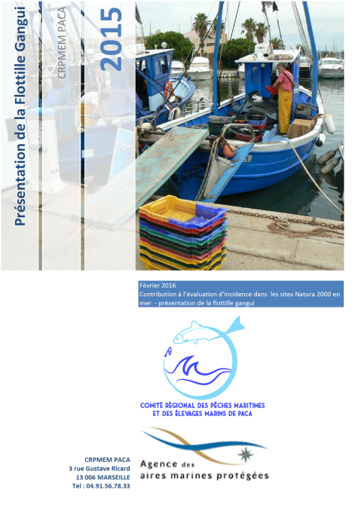
Data collection and validation
National data base for fishing activity
Surveys with fisherman to map activity (N-1): presence/ absence in a 1 min*1min square (CRPMEM), fishing gear, main target species, season, number of fishing days per different gear
Validation of the survey results in presence of all fishermen

Slide 17
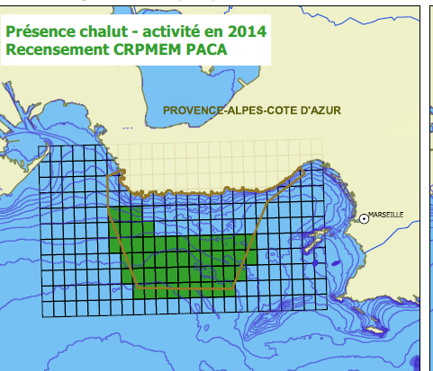
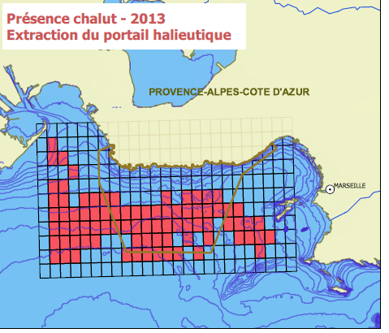
Bottom Trawl
Bottom trawling activity in 2014 (CRPMEM PACA-from fisheries industry survey)
Bottom trawling activity in 2013 (SIH/SIPA from national data basis –partnership between French Biodiversity Agency, Ifremer and ministry in charge of fisheries

Slide 18
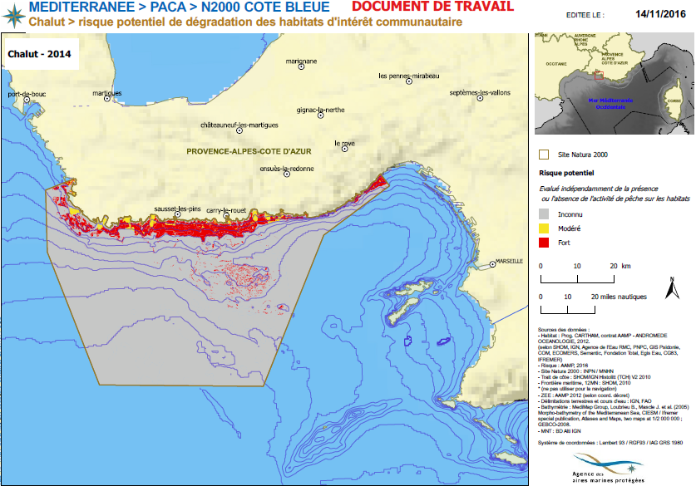
Bottow trawling-> potential risk of degradation (PACA Côte Bleue Marine)
Potential risk
unknown
moderate
High

Slide 19
Combing fishing activities and habitats
1)For each fishing gear, physical pressures are identified through a national document : Pressures/Activity –MNHN/Ifremer
2) For each pressure, the level of sensitivity of each habitat is identified through national document habitat/ pressures-MNHN
3)The level of impact generated by the fishing gear is defined. National document habitats/ fishing gear -Ifremer

Slide 20
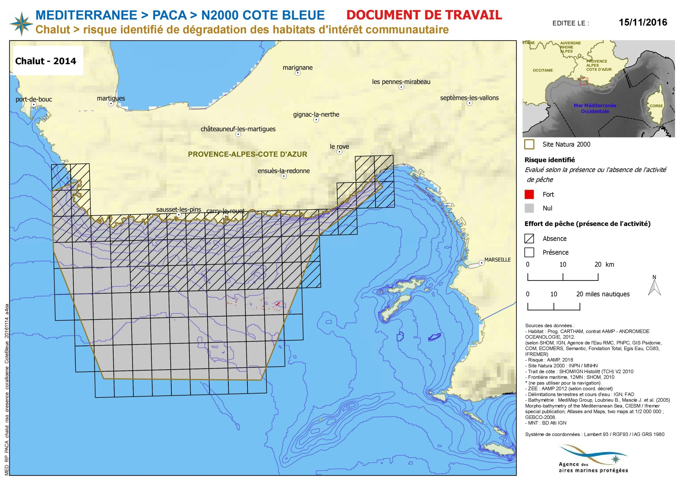
Bottom Trawling identified risk of degradation
Identified risk
high
none

Slide 21
Preliminary results
Bottom trawling interacts with 1110 Sandbanks (« SFBC- 1110-6 », « SGCF 1110-7») and with 1120 -1 posidonia meadows.
Physical pressures identified are: surface abrasion, shallow abrasion, deep abrasion, reworking of sediment and suspension of sediment.
2 sensitivity/impact scores :
- moderate/moderate for SFBC et SGCF (1110-6 et 1110-7)
- Very high/high for posidonia meadows (1120) and coralligeneous (1170).
Note: the national document doesn’t take into account the trawling/ coralligeneaous interaction because the legal framework bans this fishing gear over this habitat.
Measures proposed :
Share the knowledge with the fishermen, so they know where this habitat is. And a cooperation with surveillance authority to reinforce controls in those zones. Legislation already exists for those 2 habitats

Slide 22
Pro and cons
Actual study is based on self assessed data, with a risk of imprecision (survey for fishing activity N-1). Lots of time is needed to conduct surveys.
Fishermen are part of the process, but an additional survey is needed to validate the results. Local specificities are taken into account.
Good tool to explain the Natura 2000 process to the fishermen.
The site level approach is a relevant scale for management (ecology, economic and social issues)
Reinforce the appropriateness of the management measure and fishing activity (co-working).

Slide 23
Difficulties
Difficulties in assessing the level of risk according to the intensity of the fishing activity and hence the need to take measures.
Cumulative impacts of all fishing gears are not considered
Fisheries data and habitats are available at different scales (fisheries data for boats under 12m not concerned by VMS)
Little information on gears’ impact on « soft » sediment/habitats
Risk analysis is only conducted for habitats. The methodology for species is in development.

Slide 24
Suggestions – national level
- Take into account the variability of the activity according to the season, so as to implement measures at the right moment.
- Take into account all fishing activities in the Natura 2000 site, to be able to prioritize the measures.
- Improvement of fishery data collection

Slide 25
Suggestions – European level
Share a table online where MS indicate Natura 2000 management measures (habitats concerned, species concerned, type of pressures, fishing gear …)
Propose a request to STECF to establish a framework /recommendation on evaluation of the socio-economic impact of fishing management measure.
Propose a common standard for fishing data exchange between member states.

Slide 26
Future challenges
In the PACA region: respond to EMFF project call (measure 40) for 15 sites, AFB in partnership with CRPMEM and Natura 2000 managers
Measure implementation : surveillance, support for gradual introduction of measures (EMFF)
Monitoring
Ensure coherence between sites
Improve consideration of species: regional measures?

Slide 27
Thank you for your attention

